Slide 1
A Data Analytics Project Report on Customer Segmentation, Business Analysis and Reporting – By Nikhil B Bhosale
INDEX
Slide No | Page No. | Headings
Slide 1 | 1 | Acknowledgement
Slide 2 | 2 | Introduction
Slide 3 | 3 | Report Structure
Slide 4 | 4-10 | Product Section
Slide 11 | 11-15 | Customer Section
Slide 16 | 16-19 | Sales Section

Slide 2
Customer Segmentation, Business Analysis & Reporting for Walmart
Introduction
In today's highly competitive retail landscape, understanding customer behavior is crucial for maintaining a leading edge. This report focuses on Customer Segmentation, Business Analysis, and Reporting for Walmart, aiming to provide key insights into the diverse customer base and its impact on business performance.
The primary objective of this analysis is to group customers into distinct segments based on their purchasing behavior, demographics, and other key metrics. By doing so, Walmart can tailor marketing strategies, enhance customer satisfaction, and drive growth.
This report also explores how data-driven analysis can help Walmart in decision-making, improve operational efficiency, and optimize product offerings. The segmentation model used in this study will serve as a foundation for targeted marketing campaigns, personalized promotions, and better resource allocation.

Slide 3
Report Structure This comprehensive report is structured into three key sections, each focusing on critical aspects of Walmart’s operations:
Product Section : This section delves into Walmart's product offerings, analyzing the performance of various product categories, identifying top-selling items, and highlighting areas for potential growth. It provides insights into inventory management, product trends, and customer preferences across different segments.
Customer Section : The customer section focuses on segmentation analysis, categorizing Walmart's diverse customer base into distinct groups based on their shopping behaviors, demographics, and purchasing preferences. This analysis helps Walmart target its marketing efforts effectively and deliver personalized shopping experiences to enhance customer loyalty and satisfaction.
Sales Section : In this section, we explore Walmart's overall sales performance, analyzing revenue trends, seasonal variations, and geographic sales patterns. The data-driven insights help identify the drivers behind sales growth, as well as areas requiring strategic adjustments to optimize revenue.

Slide 4
Products Section
Please find the detailed analysis and report for the Walmart customer segmentation and business analysis according to the sales and revenue generated by the products section.

Slide 5
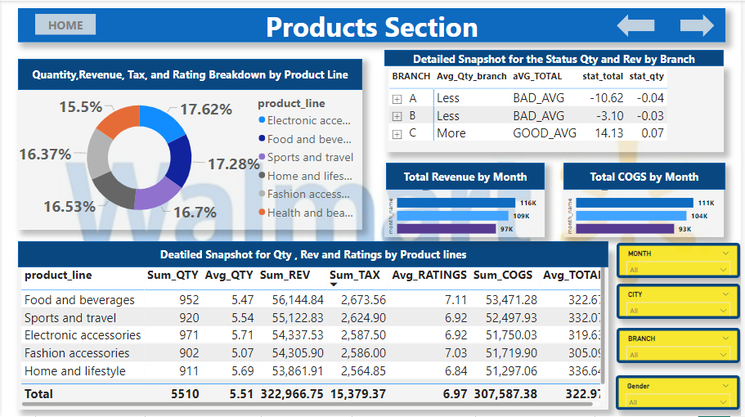
Products Section Page

Slide 6
Client requirements for the Products Section
Q1.How many unique product lines does the data have ?
Q2.What is the most common payment method ?
Q3. What is the most selling product line?
Q4.What is the total revenue by month?
Q5. What month had largest COGS ?
Q6. What product line has the largest revenue ?
Q7. Which is the city with largest revenue?
Q8. What product line had the largest vat?
Q9.Fetch each product line and add a column to those product line showing "Good", "Bad". Good if its greater than the average sales.
Q10.Which branch sold more products than average product sold?
Q11.What is the most common product line by gender ?
Q12. What is the average rating of each product line ?

Slide 7
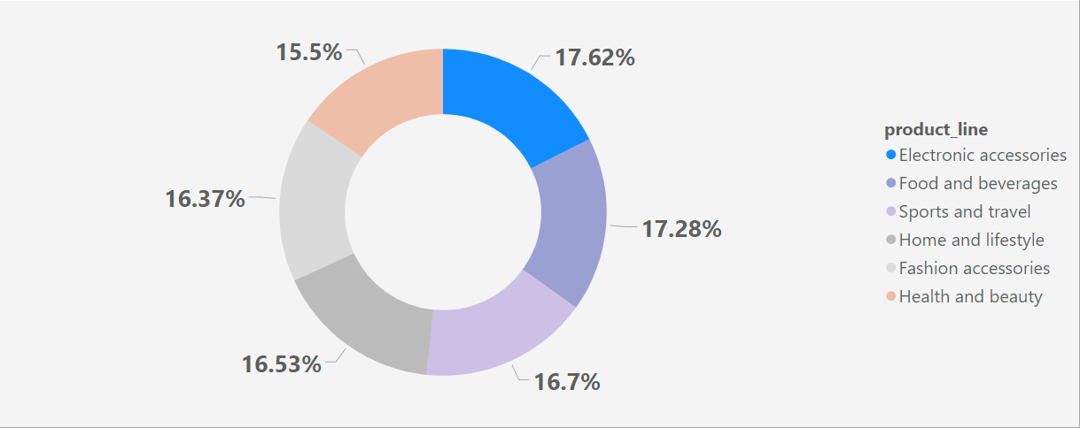
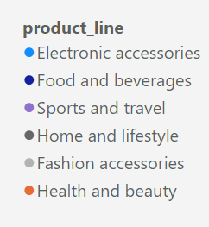
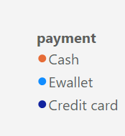
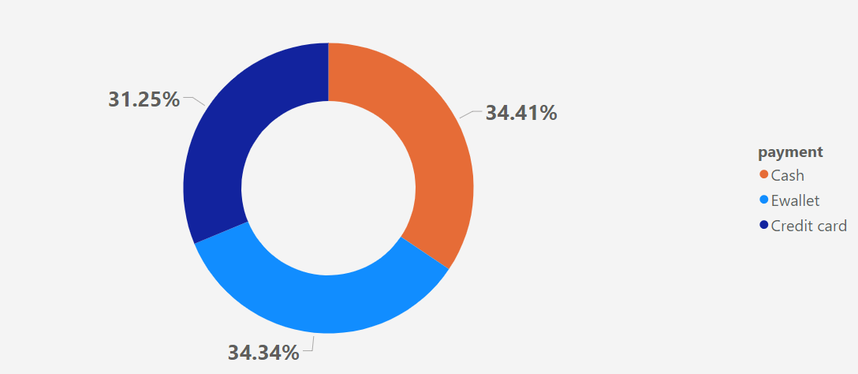
Products Segment Findings
Q1.How many unique product lines does the data have ?
Q2.What is the most common payment method ?
Q3. What is the most selling product line?
Ans :- So we conclude that the most selling product line is Electronic Accessories. Here we have counted the number of units sold by each Product line irrespective of months and found out the share of Electronic Accessories counts with 17.62% i.e., 971 units sold which is the highest among all the others.

Slide 8
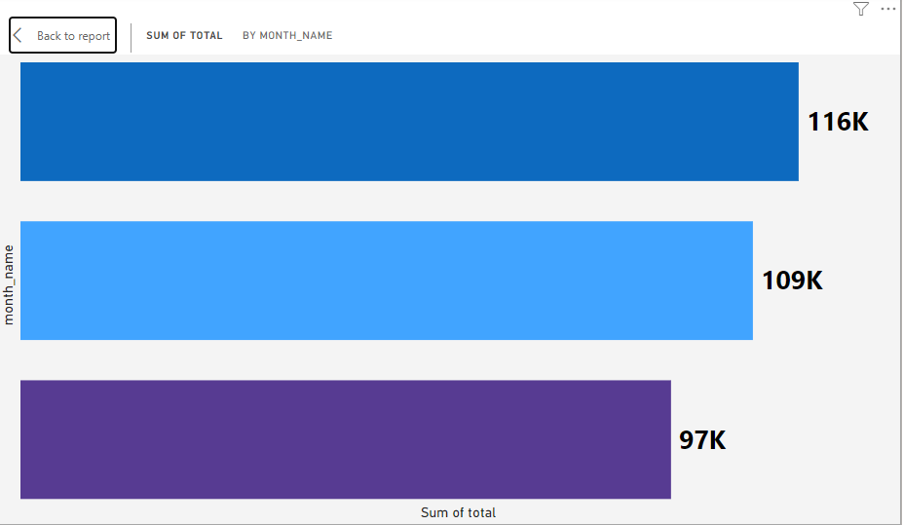

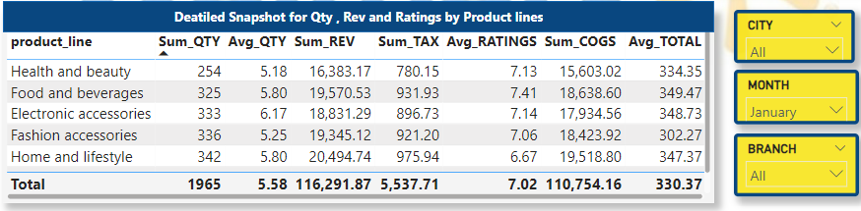
Q4.What is the total revenue by month?
To showcase the Revenue by Month we have visualized the revenue vs month names with Bar Chart which results with January month ranking at the top of other months. We have used Month filter to filter out revenue for each month . To get more detailed view we visualized the total revenue generated in the month of January through Detailed Snapshot for Qty, Rev and Rankings by Product line table which showcase the breakdown of revenue of the given month among the related Product Lines. Outcomes are January month ranks at the first position with 116K total revenue generated , followed by the other two months with March (109k revenue ) and Feb (97k revenue ) respectively. With this January has the highest share of 36.66% of the total revenue generated in all the three months.

Slide 9
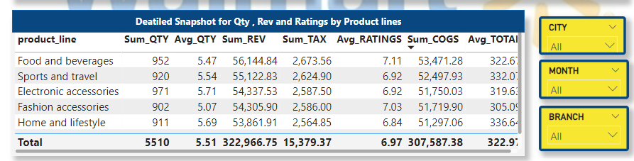
Q6.What product line has the largest revenue ? Q8. What product line had the largest vat? Q12. What is the average rating of each product line ?
Ans 6. From the Detailed Snapshot for Qty, Rev, and Ratings by Product line chart we Q12. What is the average rating of each product line ?conclude that Food and Beverages has the largest revenue generated with 56.144k than other Product lines. The total share of this product line out of all the product lines is 17.38% which is highest of all.
Ans 8. Food and Beverages writes off the largest tax /VAT which sums up to 2.673K .
Note :- Here all the visualizations from the Detailed Snapshot for Qty, Rev and ratings by Product Lines is derived with filters CITY, MONTH, BRANCH set to ALL
Ans12. The Average rating for each product line is as follows :-
Here the highest average rating is 7.11 for Food and Beverages product line . The Average rating for all the product line is calculated to be 5.51.

Slide 10
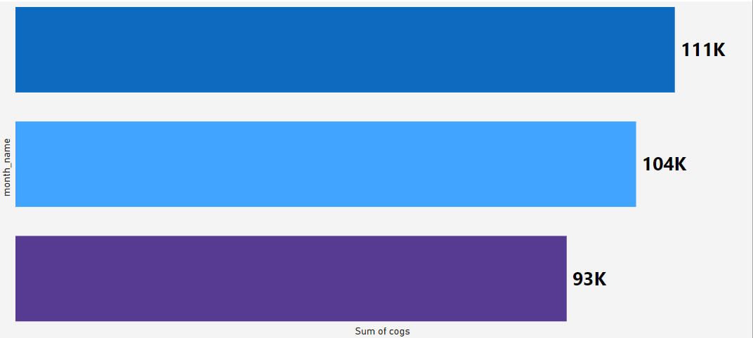
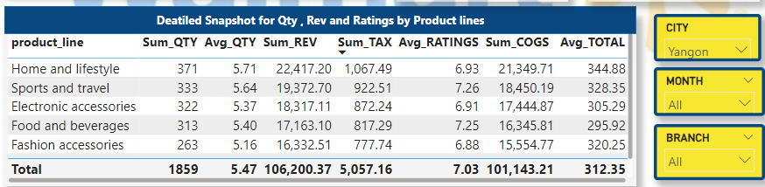
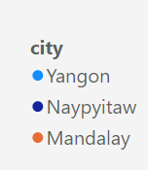
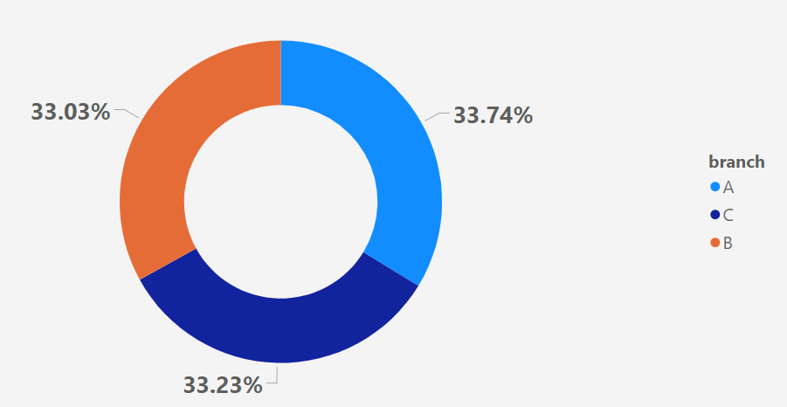

Q5. What month had largest COGS ?
January
Ans :- We conclude from the Bar chart COGS by Month name that January tops the list when it comes to generating cost of goods
March
Q7. Which is the city with largest revenue?
February
Ans. After observing the pie chart for Qty, rev and ratings for product Line we can confirm that Yangon city tops in generating revenue than other cities with 34.41% share and 106.2k of revenue in total revenue generated by all the three cities and the detailed snap shot provides us with the breakdown of the revenue of Yangon city for different product lines .
Q10.Which branch sold more products than average product sold?
Ans. Pie chart for Qty, Rev and ratings confirms us that branch A tops the rank in sales of the products with 33.74 % product volume sold out of the total sales. And the sales by branch A sums to about 1859 qty.

Slide 11
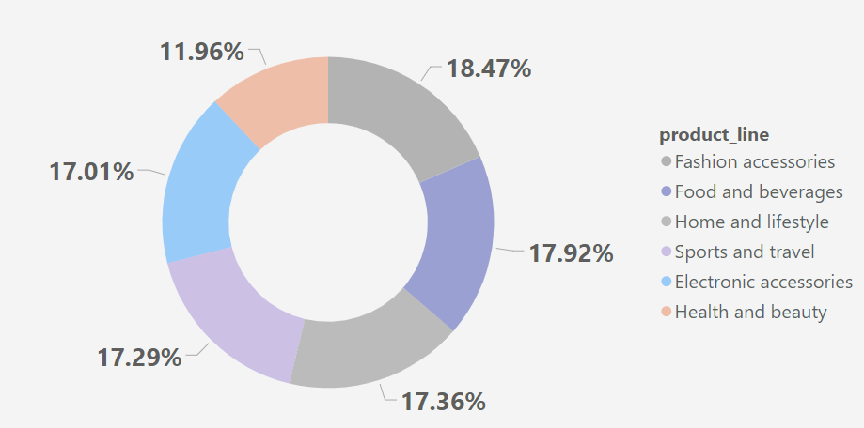
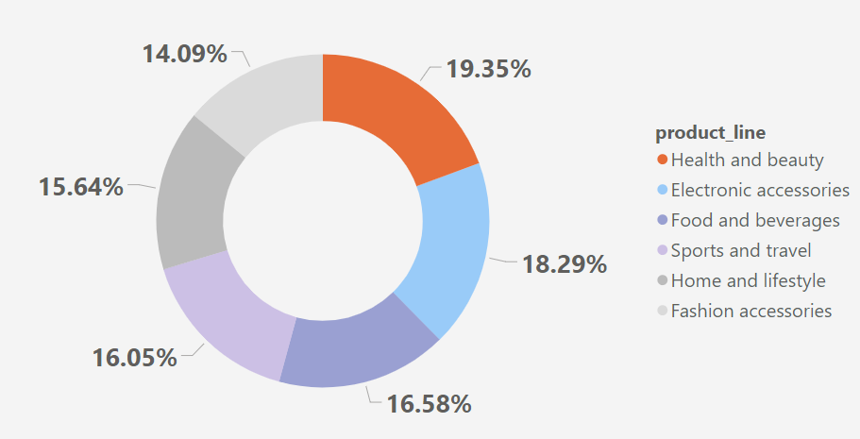
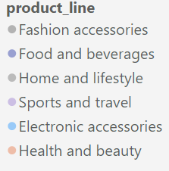
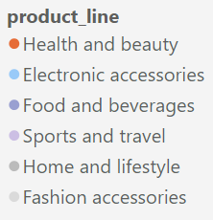
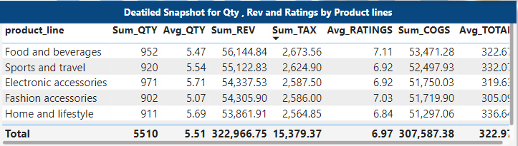


Q11.What is the most common product line by gender ?
Ans. We conclude that Product Line popular amongst Female gender is Fashion accessories which holds the highest volume of 18.49% out of the total .
Ans. And amongst Male gender Health and Beauty product line is most popular than other product lines with 19,35% of volume of the total
Q10.Which branch sold more products than average product sold?
Ans. Hence from the Detailed Snapshot for Qty, Rev and ratings by Product Line visualization we conclude the following ratings for each product line.

Slide 12
Customers Section
Please find the detailed analysis and report for the Walmart customer segmentation and business analysis according to the sales and revenue generated by the Customer section .

Slide 13
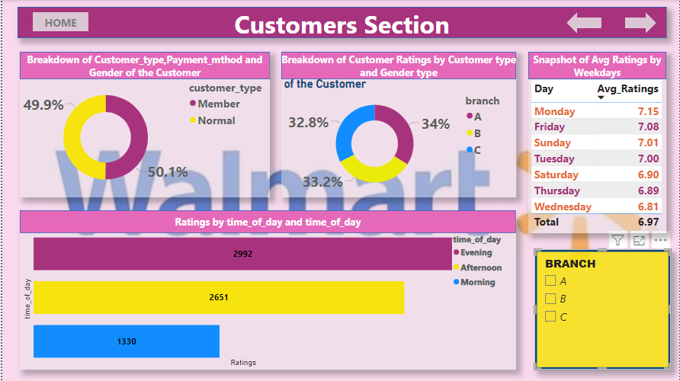
Customers Section Page

Slide 14
Client’s requirements for the Customer Section:-
Q1. How many unique customer types the data have ?
Q2. How many unique payment methods does the data have?
Q3. What is the most common customer type?
Q4.Which customer type buys the most?
Q5.What is the gender of most of the customers ?
Q6. What is the gender distribution per branch ?
Q7. Which time of the day customers give most ratings ?
Q8. Q7. Which time of the day customers give most ratings per branch ?
Q9. Which day of the week has the best average ratings ?
Q10. Which day of the week has the best average ratings per branch ?

Slide 15
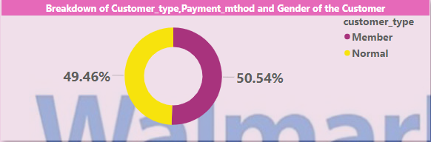
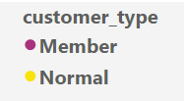
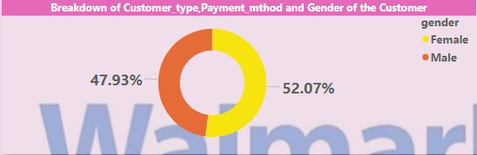
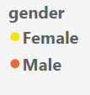
Q1. How many unique customer types the data have ?
Q2. How many unique payment methods does the data have?
Q3. What is the most common customer type?
Q4.Which customer type buys the most?
Ans. So according to the Pie chart in Breakdown of Customer_type, Payment method and Gender of the customer we conclude that Member type of customer have major share of 50.54% than Normal type with 49.46% of share of customer in sales of this business institution.
Q5.What is the gender of most of the customers ?
Q6. What is the gender distribution per branch ?
Ans. From the same visualization by drilling down to the gender wise distribution we can confirm that Female customers have the volume share of 52.07% of sales from this business institution which is slightly than that of that of male customers with 47.93%
Note :- These findings for the customer type and gender types of customers is based on the percentage of participation of the specific types for the sales in terms of quantity of the products of the given business institutions.

Slide 16
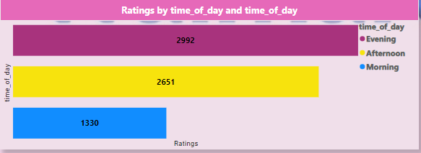
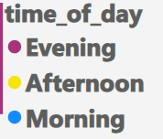
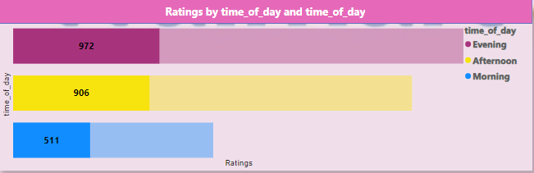
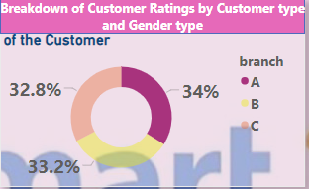
Q7. Which time of the day customers give most ratings ?
Ans. By referring to the Bar Chart visualization ratings by time of the day we conclude that mostly in the Evening customers are more active here .
Q8. Which time of the day customers give most ratings per branch ?
Ans. By referring to the following two visuals i.e., Breakdown of Customer ratings by Customer type and Gender Type(Donut Chart) & Ratings by Time of the Day (Bar Chart) , for the branch A which has highest share of 34% of the total share of all the branches of ratings irrespective of the time of the day.
For branch A we have total 972 count of ratings in the evening time. Similary we can determine the highest ratings time of the day for other branches too.

Slide 17
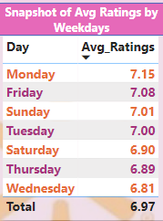
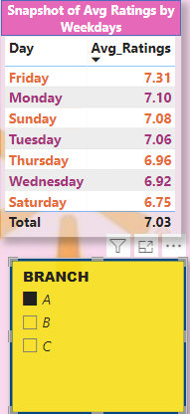
Q9. Which day of the week has the best average ratings ?
Ans. By referring to the Snapshot od Avg Ratings by days of the week we conclude that Monday ranks at the top of among the whole week with average ratings of count of 7.15irrespective of the day time .
Q10. Which day of the week has the best average ratings per branch ?
Ans. Apparently, by filtering for the section A we can confirm that for branch A on Friday we get highest average count of the ratings irrespective of the time of the day.
Similarly we found out for the other branches too , which is as follows, irrespective of the time of the day:-
Branch B :- Monday with count of average ratings as 7.34
Branch C :- Friday with count of average ratings as 7.28

Slide 18
Sales Section
Please find the detailed analysis and report for the Walmart customer segmentation and business analysis according to the sales and revenue generated by the Sales section .

Slide 19
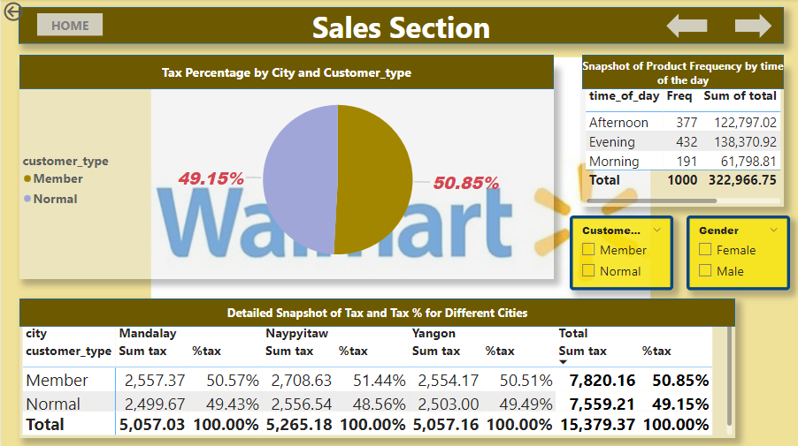
Sales Section Page

Slide 20
Client’s requirements for the Customer Section:-
Q1. number of Sales made each time of the day per week ?
Q2. Which of the customer types brings the most revenue ?
Q3. Which city has the largest tax percent /vat?
Q4. Which customer type pays the most vat?

Slide 21
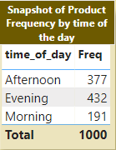
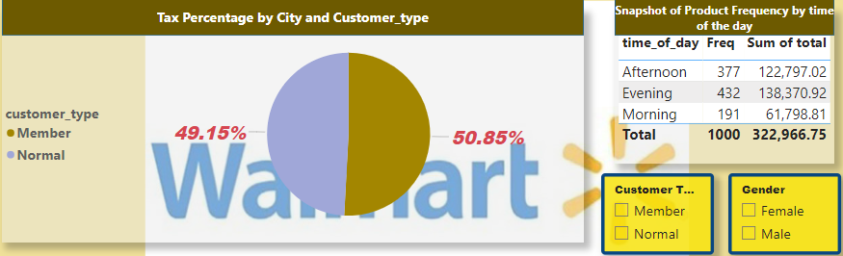
Q1. Number of Sales made each time of the day per week ?
Ans. By referring to the visual of Table Snapshot of Product Sales Frequency by the Time of the day for the whole week we conclude that Afternoon has the highest frequency of sales.
Q2. Which of the customer types brings the most revenue ?
Ans. By referring to these two visuals together i.e., Pie chart “Tax Percentage by City and Customer_type” and Table “Snapshot of Products Frequency by Time of the day ” we can easily conclude that Member type of customer have 50.85% of 322,966.75 which sums to about 164228.24 while Normal type of customer has 49.15% of the total revenue generated which sums to about 158738.1576

Slide 22
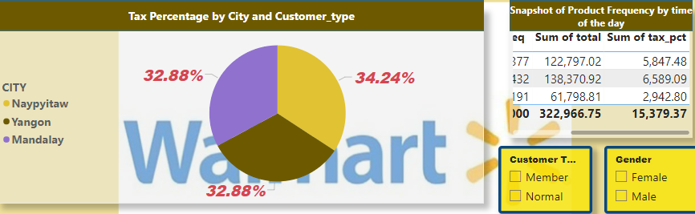
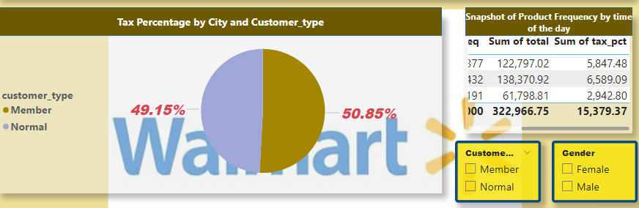
Q3. Which city has the largest tax percent /vat?
Ans. By referring to the Pie Chart Tax Percentage by City and Customer Type we can conclude that Naypyitaw city pays the majority of the tax .ie., 32.88% of the total tax i.e., 15379.37 which sums to about 5056.74.
Q4. Which customer type pays the most vat?
Ans. Again, by referring to the Pie Chart Tax Percentage by City and Customer Type we can conclude that Customer type Member pays the majority of the tax .ie., 50.85% of the total tax i.e., 15379.37 which sums to about 7820.401

Slide 23
Resources and Tools used :-
Dataset :- https://www.kaggle.com/datasets/yasserh/walmart-dataset
Tools Used :-
SQL for Data preparation and EDA
Microsoft Power BI for Visualizations Dashboard and Reporting
MS Power Point for Professional Report Making .
Git Hub :- https://github.com/NikhilGit3432
GitHub Repository :- https://shorturl.at/Qqflm
Linked In :- https://shorturl.at/ds1Bu
Email :- bhosalenikhil265@gmail.com

